Slide 1

Vishal kumar
Telecom Churn Prediction
Batch-02

Slide 2
AGENDA
1. What is Telecom Churn ?
6. Data Cleaning and Preprocessing
2. Our Mission and Vision
7. ML Model Building
3. Our Goals
8. Hyperparameter Tuning
4. Our Milestones
9. ROC and Confusion Matrix
5. Challenges
10. Conclusion

Slide 3

What is Telecom Churn ?
Telecom Churn is the rate at which costumers leave a Telecom provider, impacting revenue and market share. It includes voluntary(customer-initiated) and involuntary(provider-initiated) churn, with companies using strategies like better pricing, improved service, and loyalty programs to reduce it.

Slide 4

Our Mission and vision
Telecom Churn prediction contributes to the overall success and competitiveness of telecom companies in a rapidly evolving market landscape.
Telecom churn prediction can drive significant improvements in customers satisfaction, business performance and competitiveness within the telecommunication sector

Slide 5

Our goals
Identifying at-risk customers
Improving Customer retention
Enhancing Customer Satisfaction
Increase Revenue
Reducing acquisition efforts
Improving Service Quality

Slide 6

Our Milestones
Data Gathering & Understanding the Dataset
Data Cleaning & Pre-processing
Machine Learning Model Building
Hyperparameter Tuning & Confusion matrix

Slide 7

Challenges
Data Quality and Integration
Imbalanced Data
Dynamic Customer Behavior
Scalability
Real-Time Prediction

Slide 8
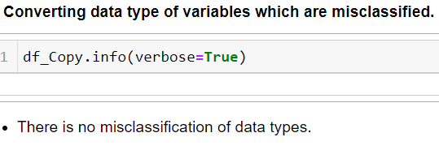

Data cleaning & pre-processing
Convert datatypes of Variables which are misclassified :-
Ensures accurate analysis and efficient processing.
Code Snippet

Slide 9
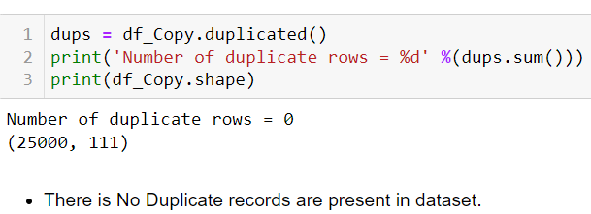
Data cleaning & pre-processing
Removing Duplicate records :-
Ensures accuracy, maintain integrity and optimize efficiency in data management and analysis.
Code Snippet

Slide 10
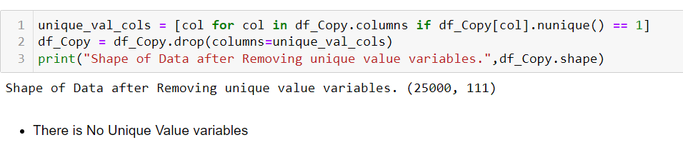
Data cleaning & pre-processing
Removing Unique Value Variables :-
Necessary to avoid redundancy, improve efficiency and ensures meaningful analysis.
Code Snippet

Slide 11
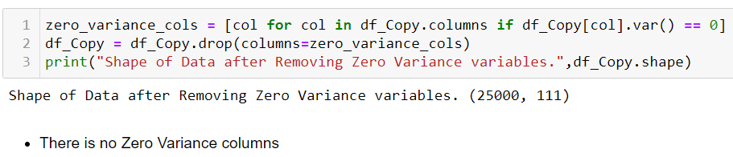
Data cleaning & pre-processing
Removing Zero Variance Variables :-
Necessary to eliminate redundant information, improve model stability and simplify interpretation.
Code Snippet

Slide 12
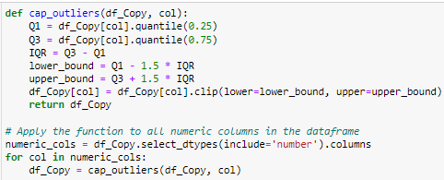
Data cleaning & pre-processing
Outlier Treatment :-
Necessary to maintain data integrity, improve model performance and ensures robust and interpretable analysis.
Code Snippet

Slide 13
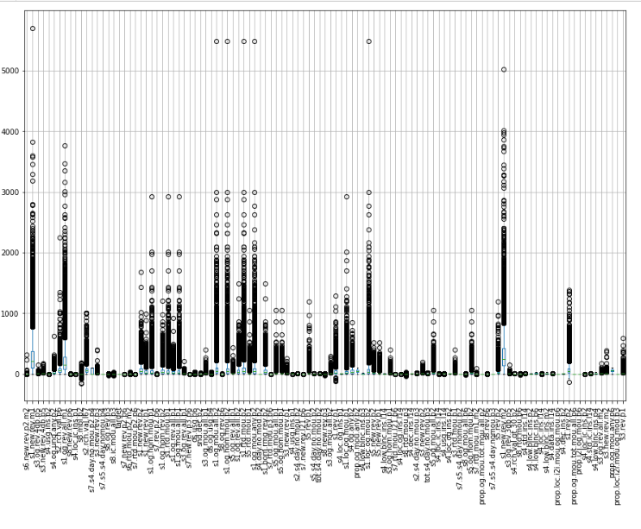
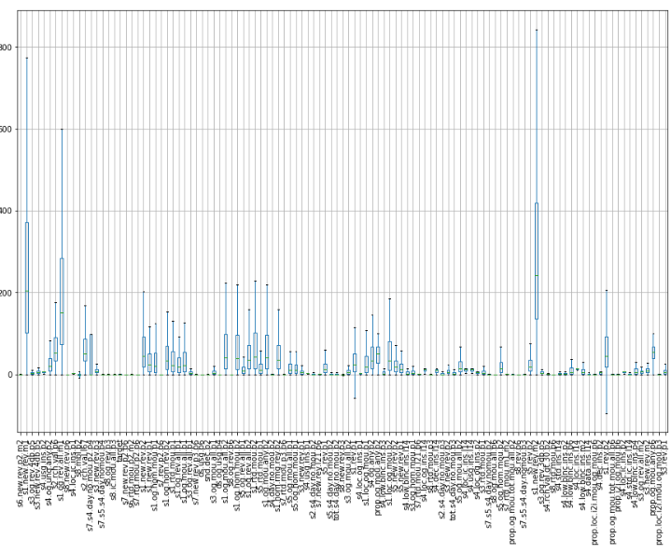
Data cleaning & pre-processing
Outlier Treatment :-
Before
After

Slide 14
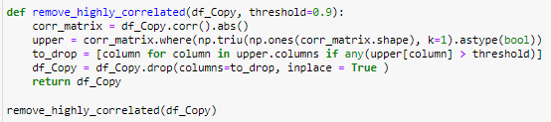
Data cleaning & pre-processing
Removing Highly correlated Variables :-
Necessary to reduce redundancy, improve stability and enhance efficiency in model training and interpretation
Code Snippet

Slide 15
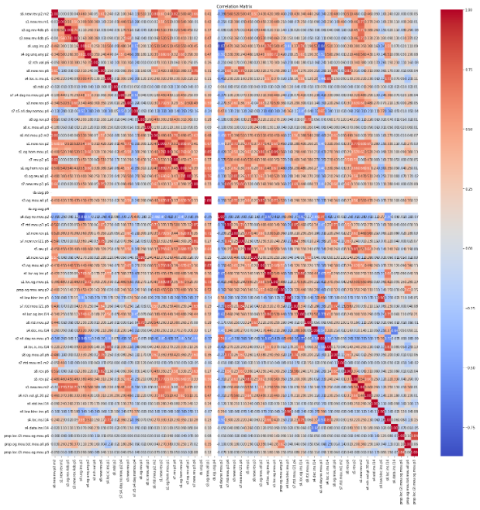
Data cleaning & pre-processing
Removing Highly correlated Variables :-

Slide 16
Data cleaning & pre-processing
Missing Value Treatment :-
Essential for maintaining data integrity, improve model performance and ensures accurate and statistically valid analysis
Multicollinearity (VIF>5):-
Crucial to ensure accurate, stable and interpretable model.

Slide 17
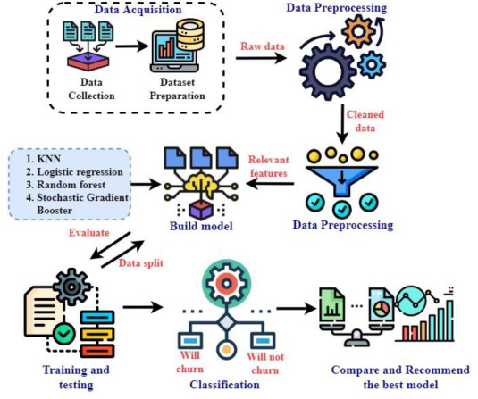
Machine learning model building
Random Forest
Logistic Regression

Slide 18
Random forest
Random forest is an ensemble learning method used for classification, regression and other tasks, which operates by constructing multiple decision tress during training and outputting the mode of the classes (classification) or mean prediction(regression) of the individual tress.
Key Characteristics :-
Ensemble Method
Bagging Technique
Random Feature Selection
High Accuracy
Robustness

Slide 19
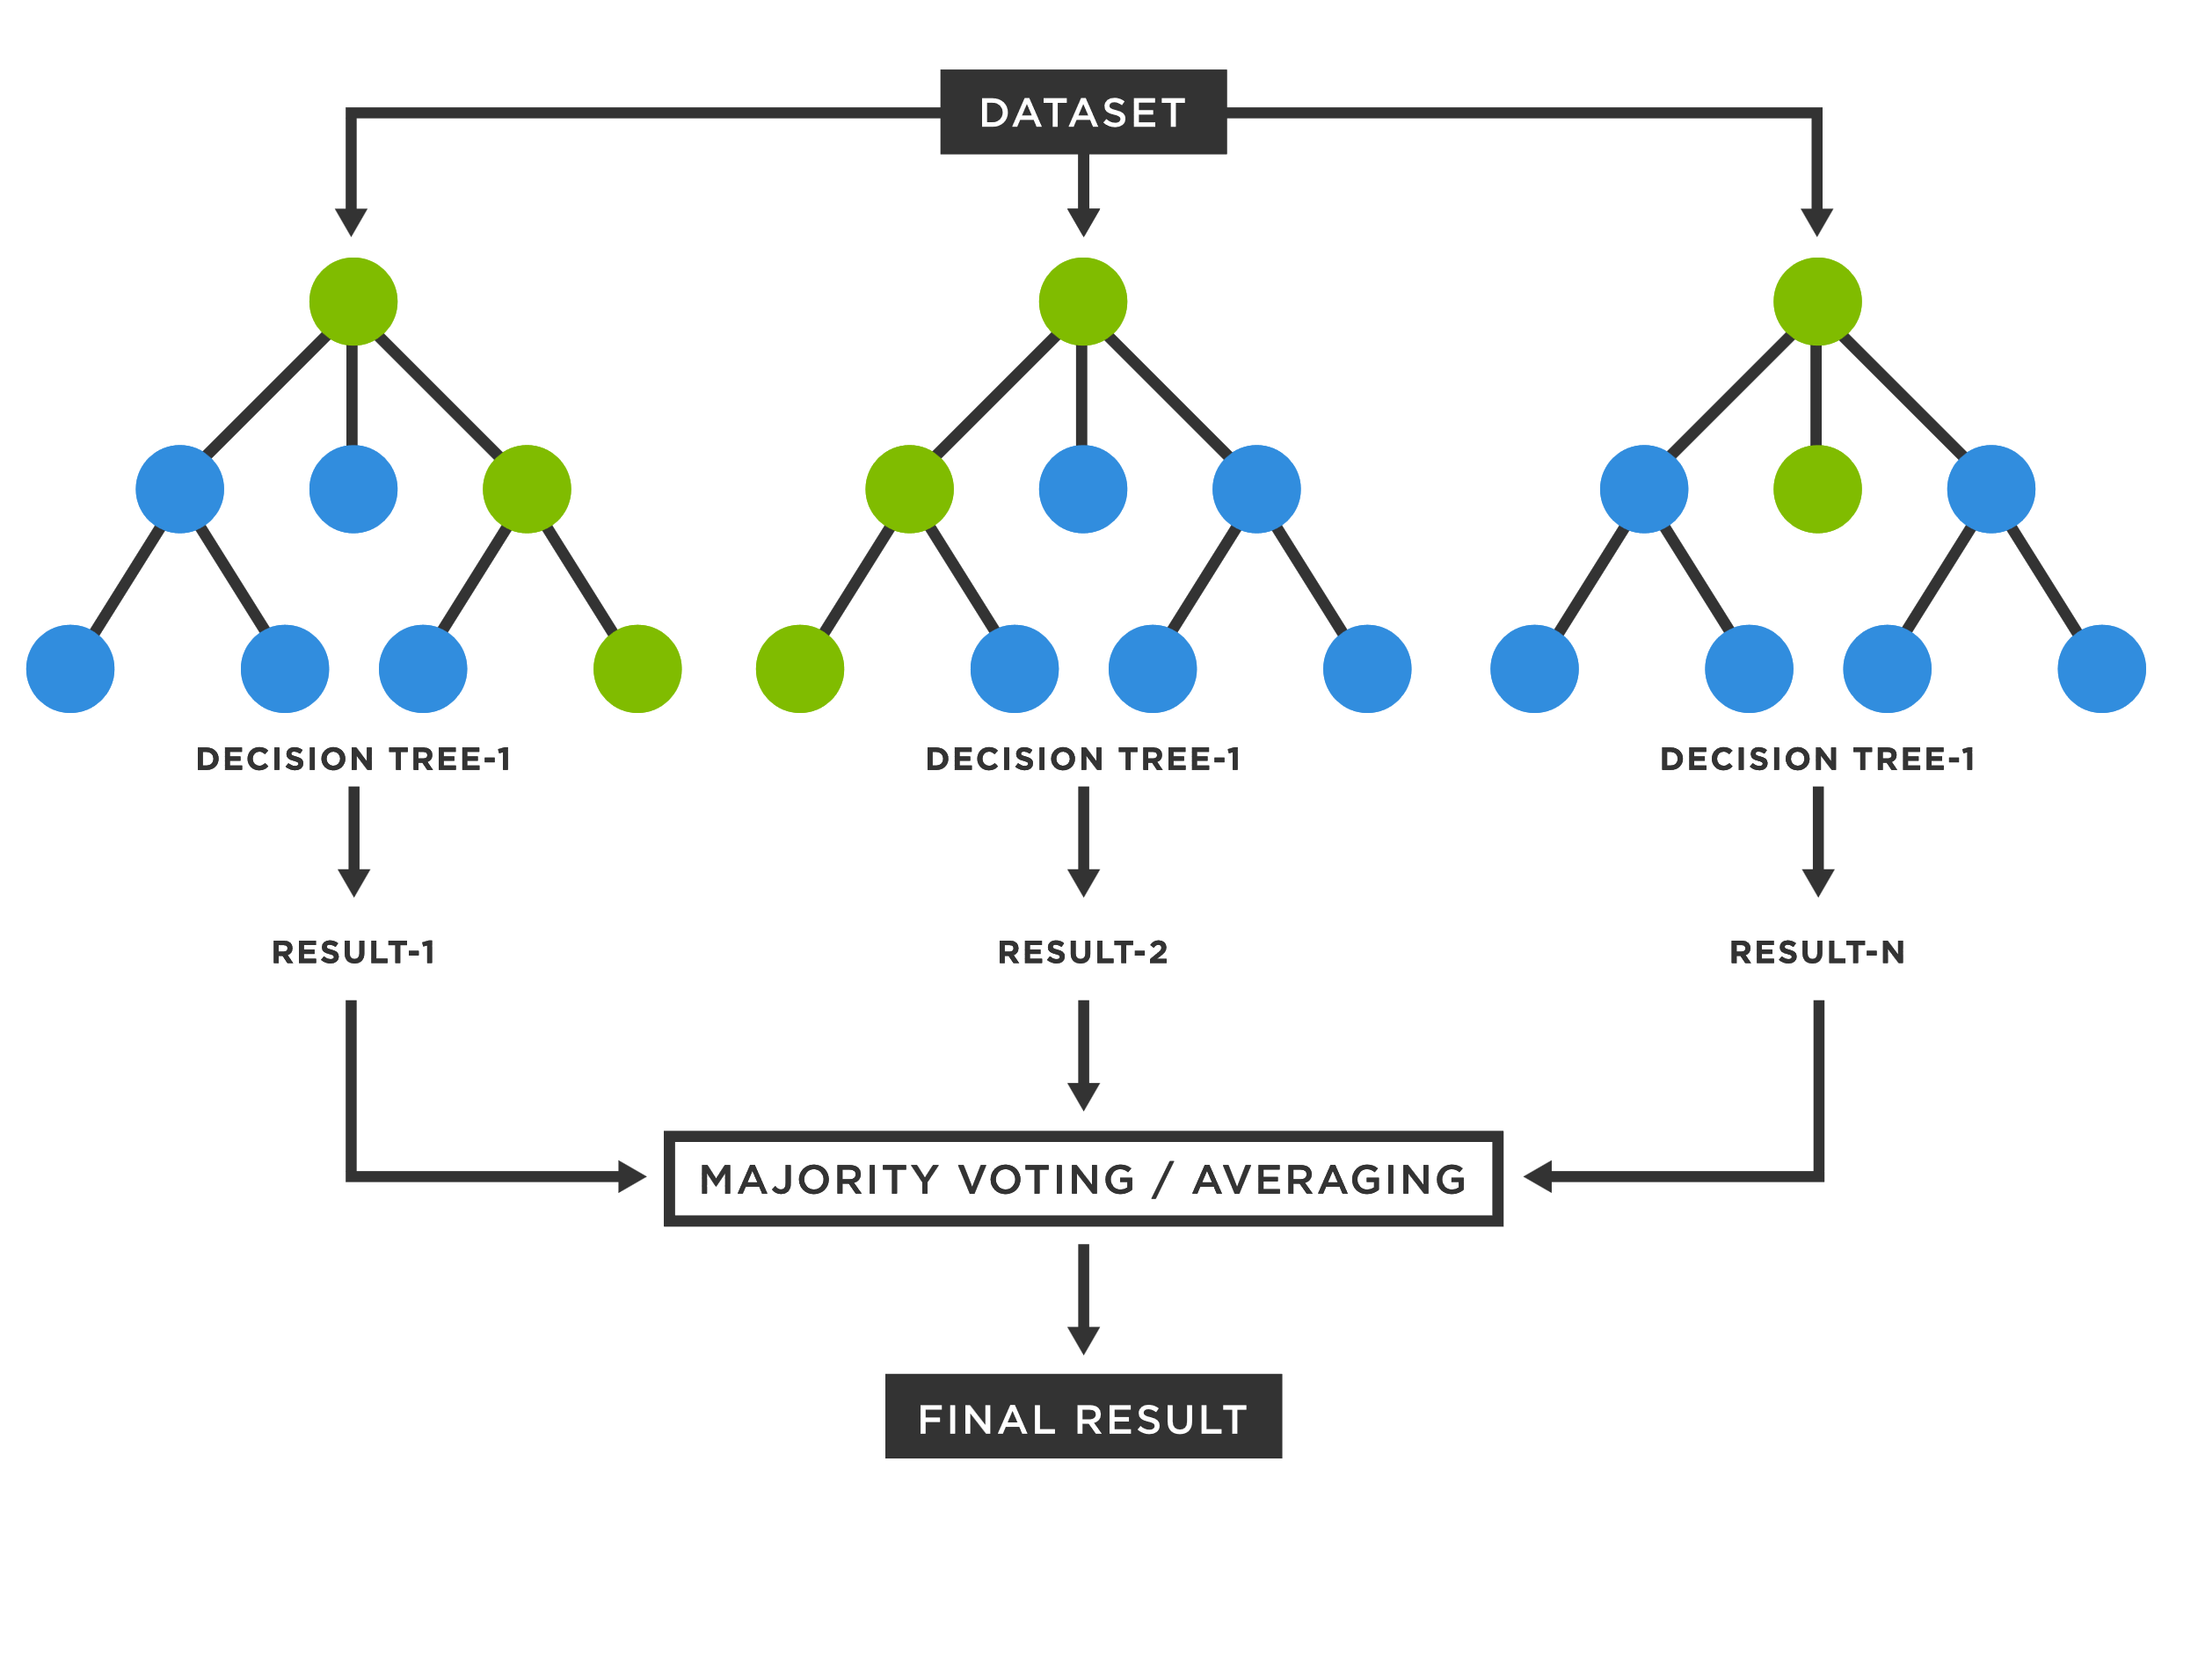
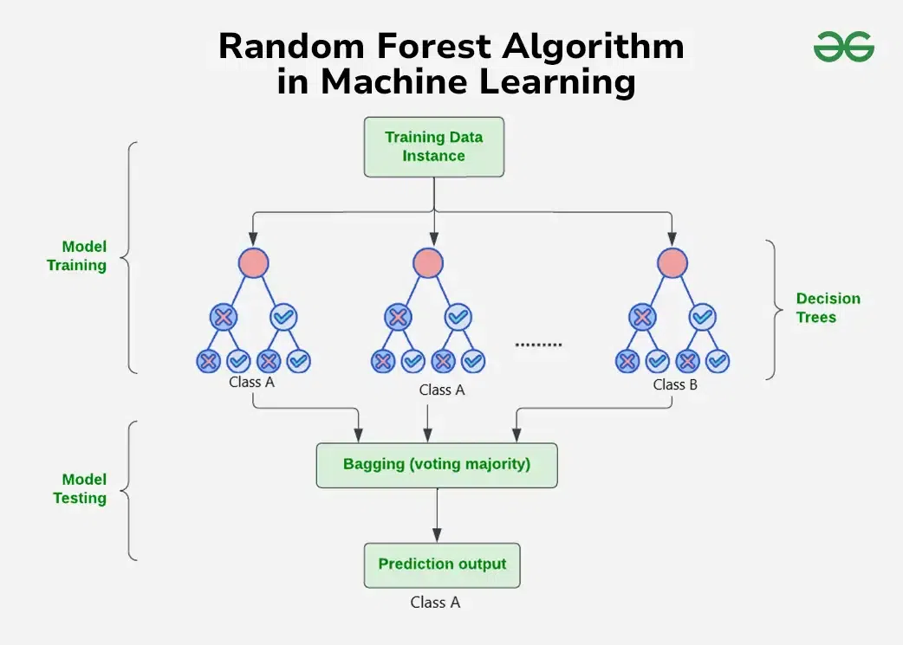
Random forest

Slide 20
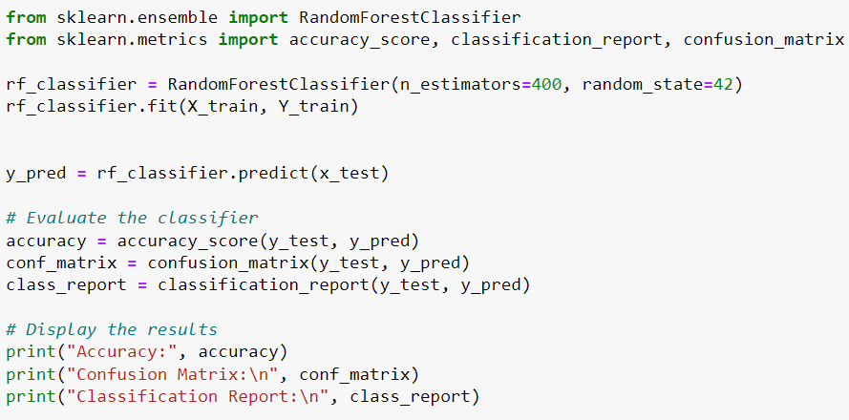
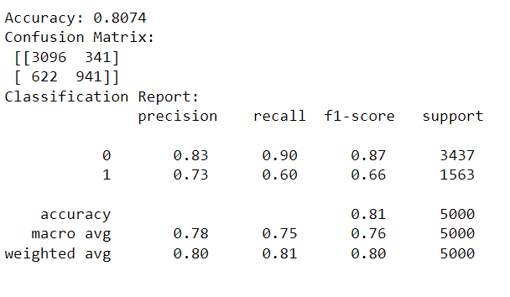
Random forest code snippet

Slide 21
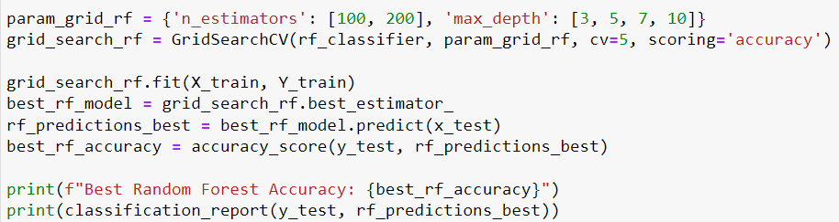
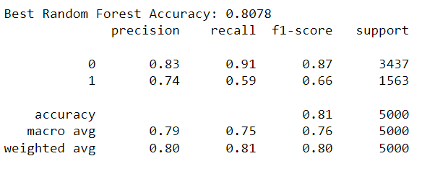
Random forest (hyperparameter tuning)

Slide 22
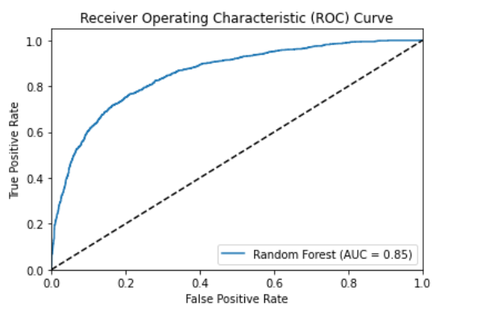
Random forest (ROC)

Slide 23
Logistic regression
Logistic Regression is a statistical method used for binary classification problems, where the outcome is a categorical variable with two possible values, typically 0 and 1.
Key Characteristics :-
Binary Classification
Logistic Function
Linear Relationship
Odds & Log Odds
Maximum Likelihood Estimation
Interpretability

Slide 24
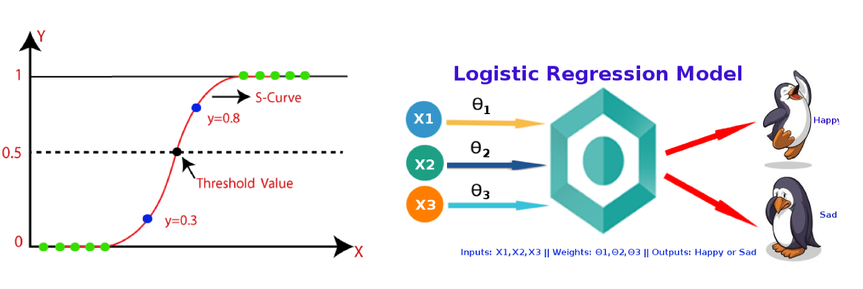
Logistic regression

Slide 25
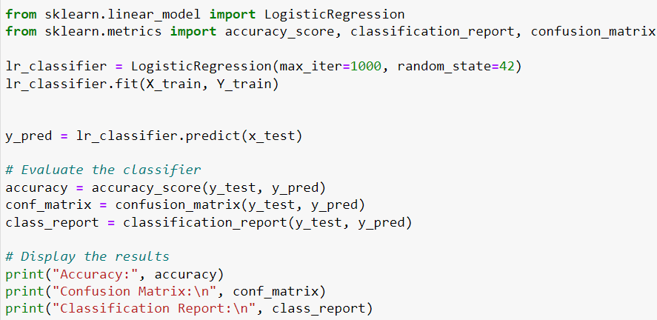
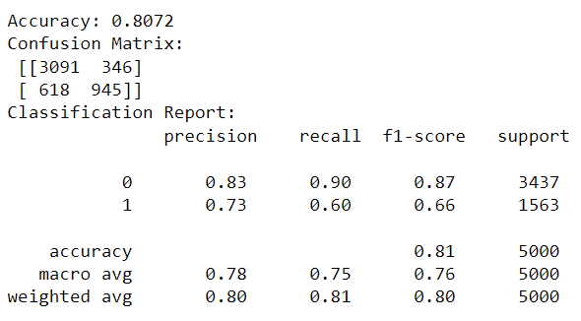
Logistic regression code snippet

Slide 26
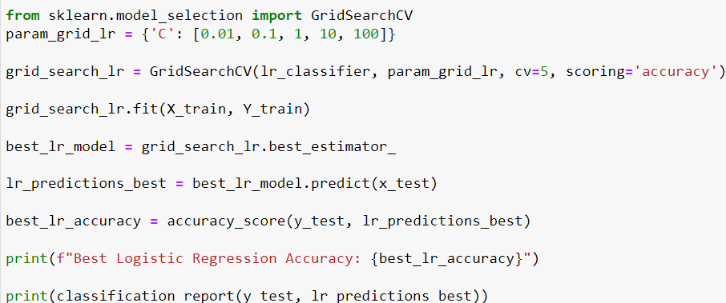
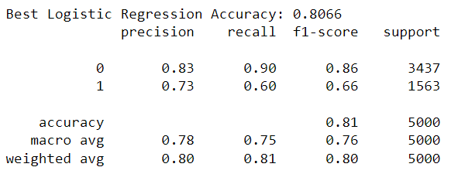
Logistic regression(hyperparameter tuning)

Slide 27
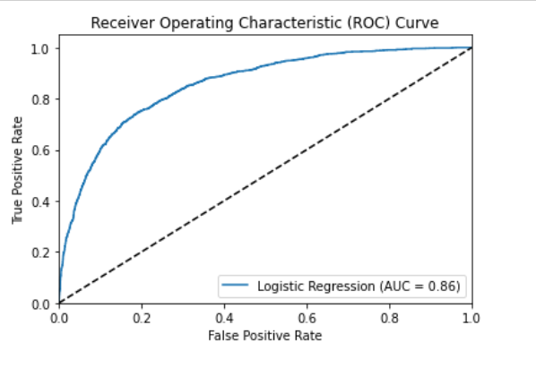
Logistic regression(Roc)

Slide 28
conclusion
Improved Customer Retention :-
By accurately predicting which customer are likely to churn, telecom companies can implement targeted strategies to retain valuable customers, ensuring their satisfaction and loyalty
Cost Reduction :-
Preventing churn is more cost-effective than acquiring new customers. Churn Prediction allows for efficient resource allocation and reduces cost associated with customer attrition
Enhanced Customer Experience :-
Understanding customer behaviour and preferences enables telecom providers to offer personalized experiences, address concerns proactively, and significantly improve overall satisfaction
Competitive Advantages :-
Effective churn prediction and management provide telecom companies with a competitive edge through superior service, tailored offers, and proactive retention initiatives

Slide 29
Thank You

